Slide 1
Pollinator Count

Slide 2
Key vocabulary
Habitat | The place where an animal, plant or other organism lives
Quadrat | A frame that outlines a sample area in a survey. Often a quadrat is 50cm by 50cm, or one quarter of a square metre.
Pollinator | Something, such as an insect, that carries pollen from one plant or part of a plant to another

Slide 3
Learning outcomes
count and identify insect pollinators in different groups
recognise different flower types
know why doing the Pollinator Count is important

Slide 4
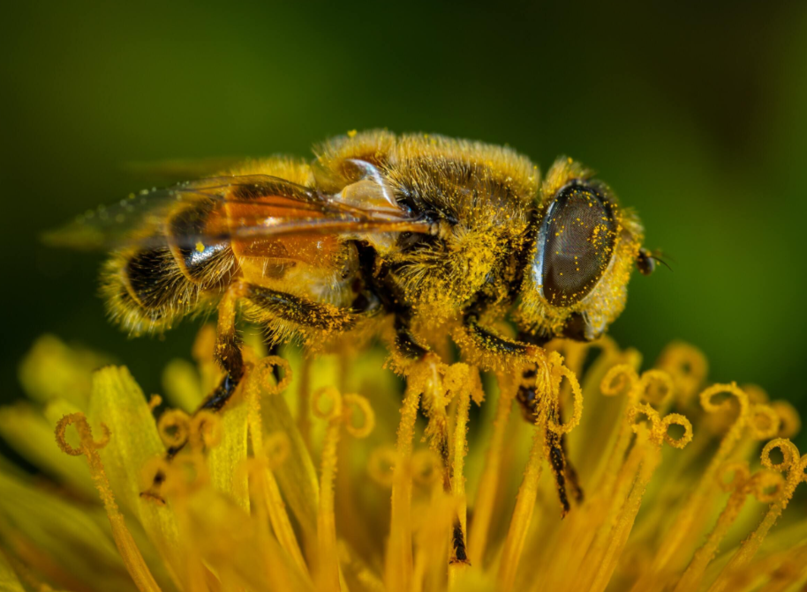
Why are pollinators important?
some plants that produce food for humans, such as apples, strawberries, tomatoes and chocolate, produce much less fruit without insect pollinators
insect pollination contributes over £600 million per year to the UK economy
they are an indicator of how healthy the environment is

Slide 5
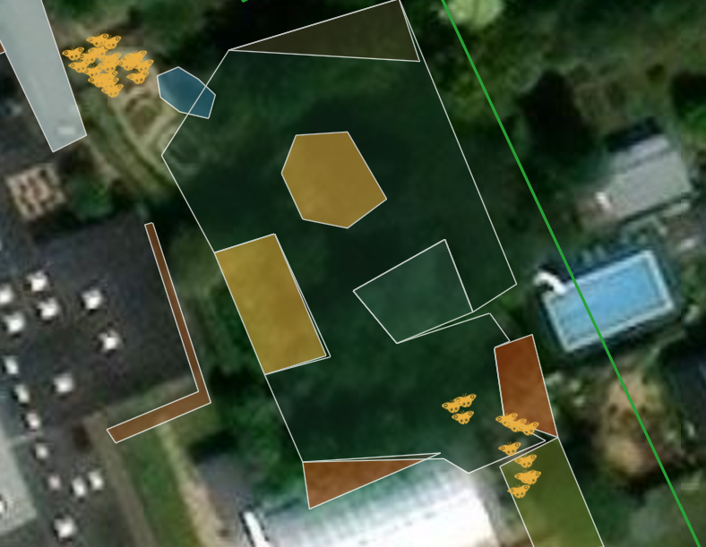
What questions can we answer by counting pollinators?
Which plants are preferred by different pollinators?
How effective are different habitat enhancements at school? e.g. planting flowers versus letting a meadow grow
How do pollinator numbers change during the year and from one year to the next?
This school used the Pollinator Count to compare two different habitats they had mapped

Slide 6
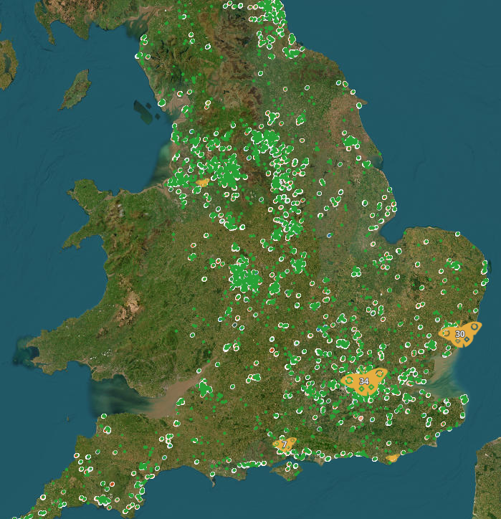
What questions need data from across the country to be answered?
Some possibilities:
How important are educational sites for pollinators?
What is the national impact schools are having on nature?
How do pollinator populations vary across the country?

Slide 7
How to do the Pollinator Count

Slide 8

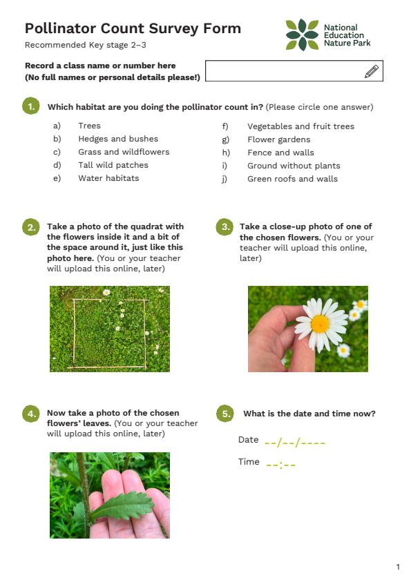
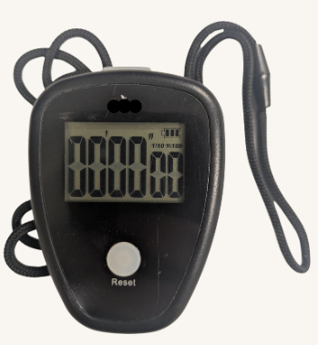
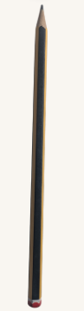
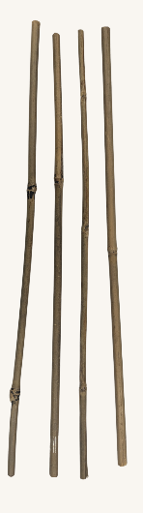
Equipment
clipboard
pencil
survey form and ID guide
timer
tools for marking a 50cm x 50cm area
(quadrat)

Slide 9
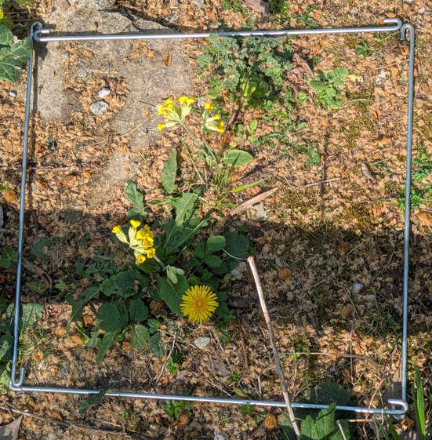
Before you start
Once we are outside you will:
put your quadrat over a patch of flowers
choose one species of flower within your quadrat to focus on
make sure your shadow is not covering the quadrat
There are multiple species in this quadrat, make sure you only choose one of them to focus on

Slide 10
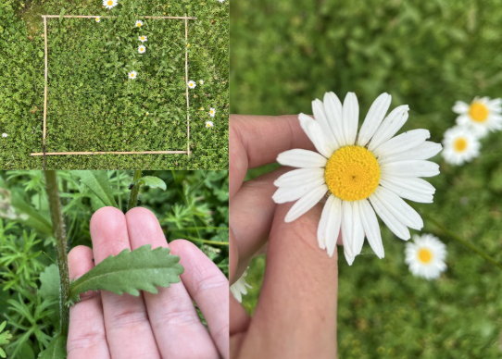
First part of the count
You will write down what habitat you are in.
If you have a camera, you will then take three photos:
the quadrat from above
a close up of your chosen flower species
a close up of your chosen flower's leaves
An example of the three photos
Notes:
If your class or group does not have access to mobile devices or cameras and you can't take photos then you can remove this slide

Slide 11
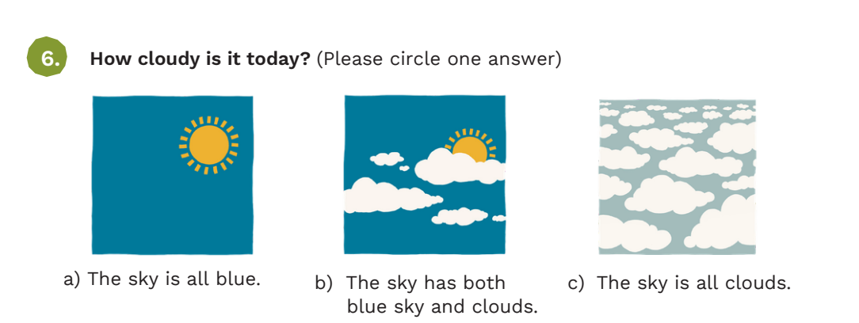
You will then:
write down the date and time
write how cloudy it is today

Slide 12
Second part of the count
You will be doing your count. For 5 or 10 minutes you will count every insect that lands on your chosen flower.
For each individual insect you see you will put them into one of 11 groups:
bumblebees and look-alikes | butterflies and moths
honeybees | beetles
solitary bees | tiny insects
wasps | other insects
hoverflies | we don't know what it is
other flies
Notes:
Emphasise that it is only insects that land on the flower. Remind them that if the insect doesn't land then to not count it. Also, if the same individual leaves the quadrat and comes back in then they don't count it again.

Slide 13
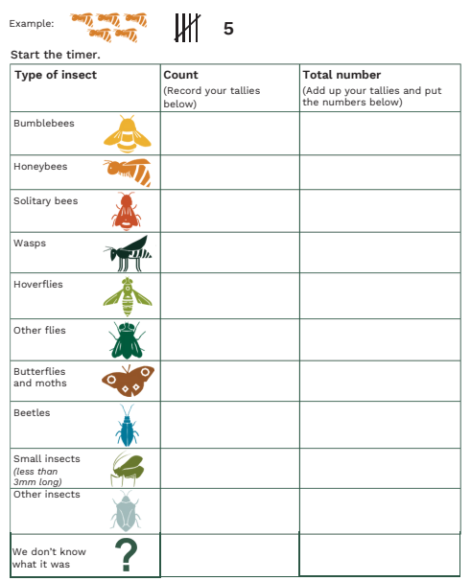

Slide 14
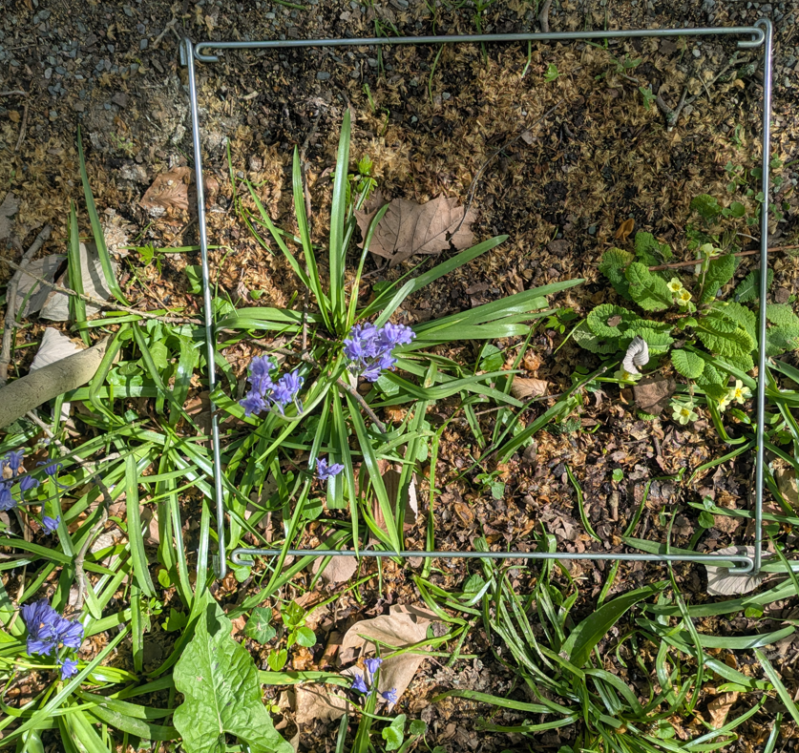
During the count
Tally any insects that land on your chosen flowers
  NOT if they fly past, or are on the leaves, or closed buds, or seed heads, or outside the quadrat
We are only counting what lands on the open flowers of our chosen flower
Pay attention. There might be really tiny insects on the flowers, so look carefully.
Stay still and quiet and leave space for the pollinators to fly in

Slide 15
Third part of the count
You will then write:
how sunny was your quadrat during the count
how windy it is today
the temperature in ºC
the name of your chosen type of flower, if you know what it is
e.g. Daisy (Bellis perennis)
how much of your quadrat is covered by your chosen flower

Slide 16
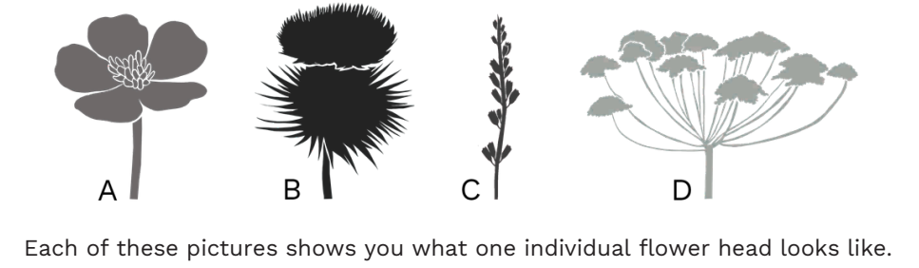
You will then:
note which of the following your chosen flower looks like
count how many flower heads of your chosen flower you can count in the quadrat
write if there are any flowers growing outside your quadrat

Slide 17
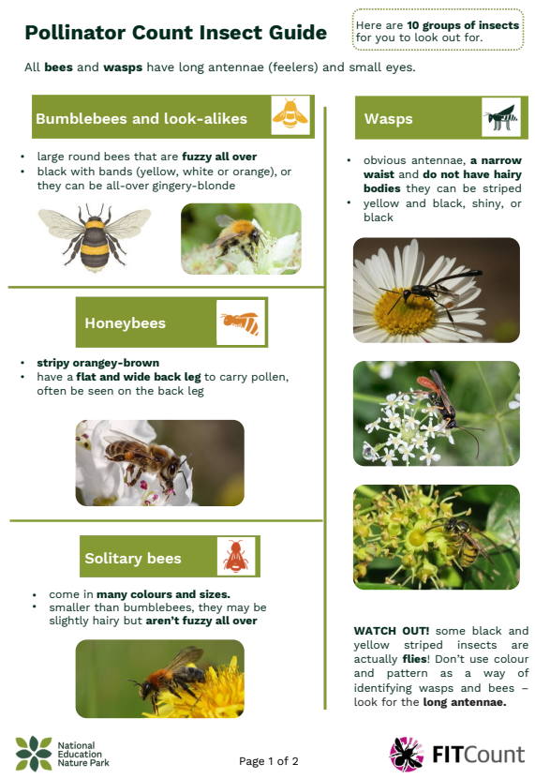
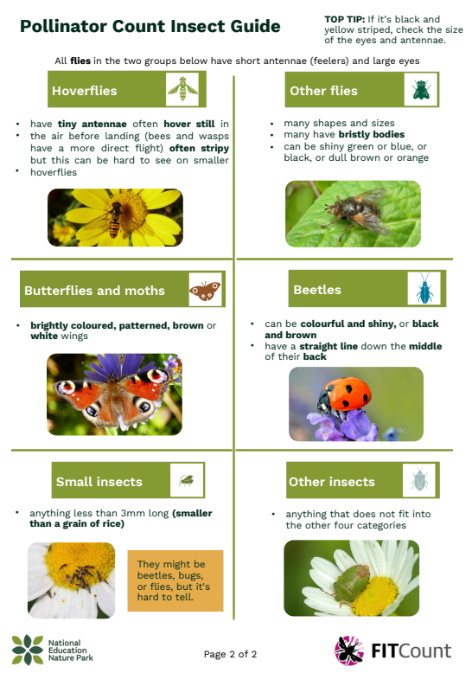
How to identify the different insect groups
Use the guide during the survey to help you work out which insect goes in which group.

Slide 18
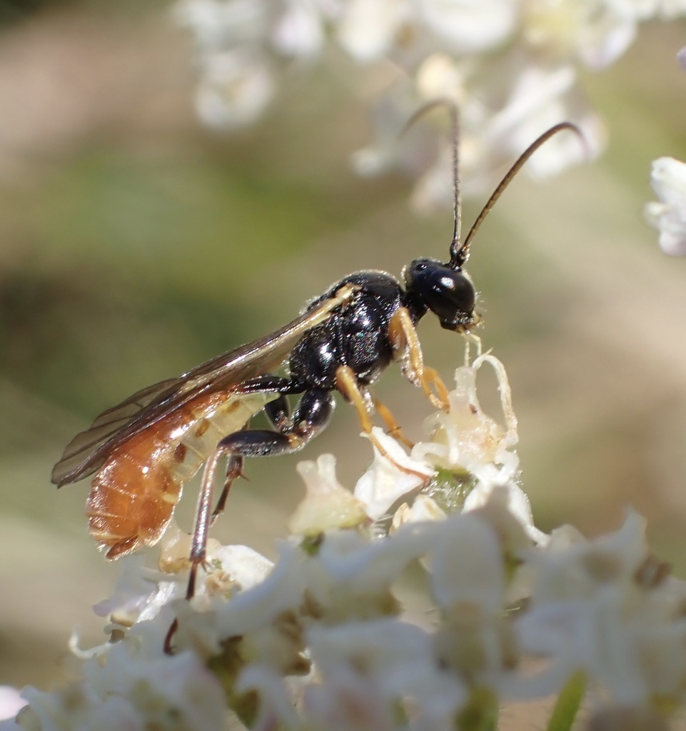
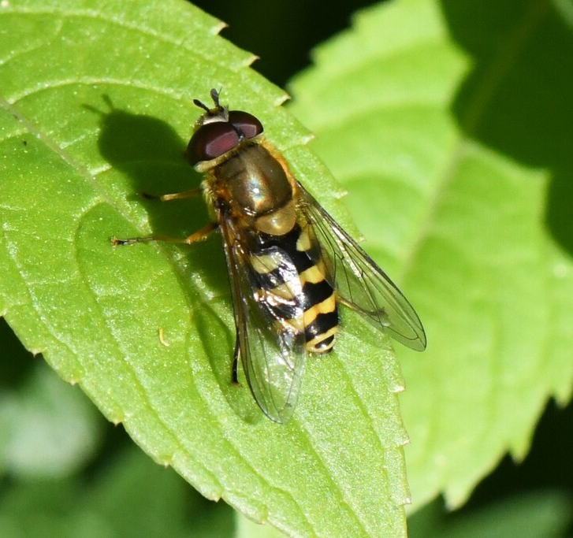
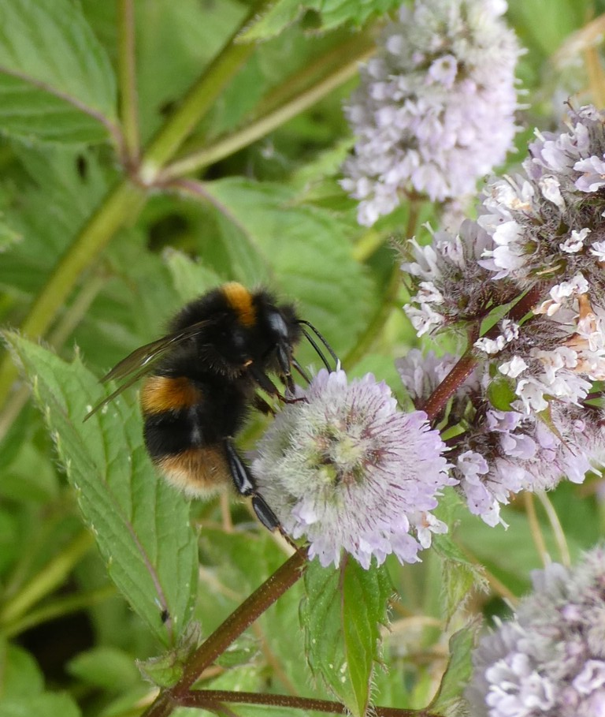
Key parts of an insect to look for
size – large?
fuzziness – all over?
antennae – long or short?
waist – pinched?
eyes – big eyes?
Notes:
https://www.inaturalist.org/observations/170328579

Slide 19
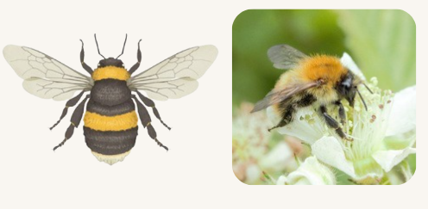
Bumblebees and look-alikes
large round bees that are fuzzy all over
black with bands (yellow, white or orange), or they can be all-over gingery-blonde

Slide 20
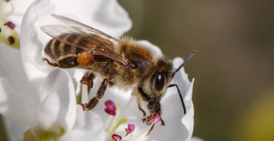
Honeybees
stripy orangey-brown
have a flat and wide back leg to carry pollen, often be seen on the back leg

Slide 21
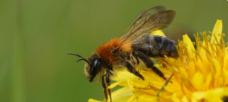
Solitary bees
come in many colours and sizes
smaller than bumblebees, they may be slightly hairy but aren’t fuzzy all over

Slide 22
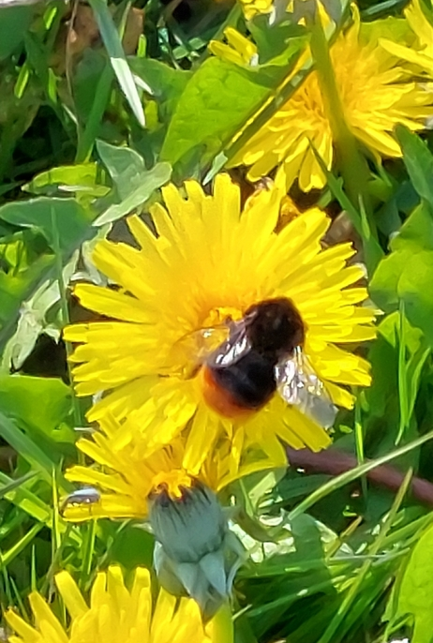
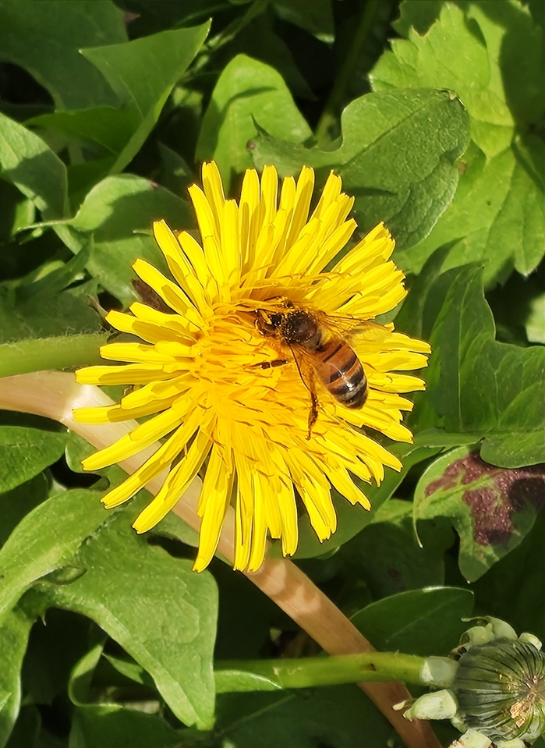
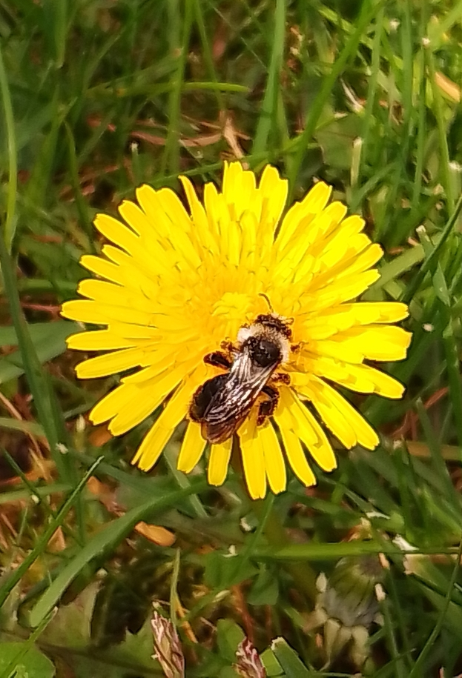
Honeybee, solitary bee or bumblebee?
Bumblebee
Honeybee
Solitary bee

Slide 23
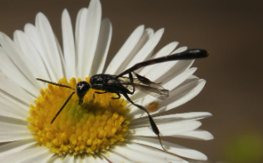
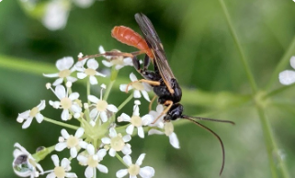
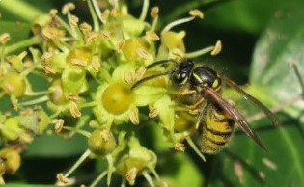
Wasps
obvious antennae, a narrow waist and do not have hairy bodies
they can be striped yellow and black, shiny, or black

Slide 24
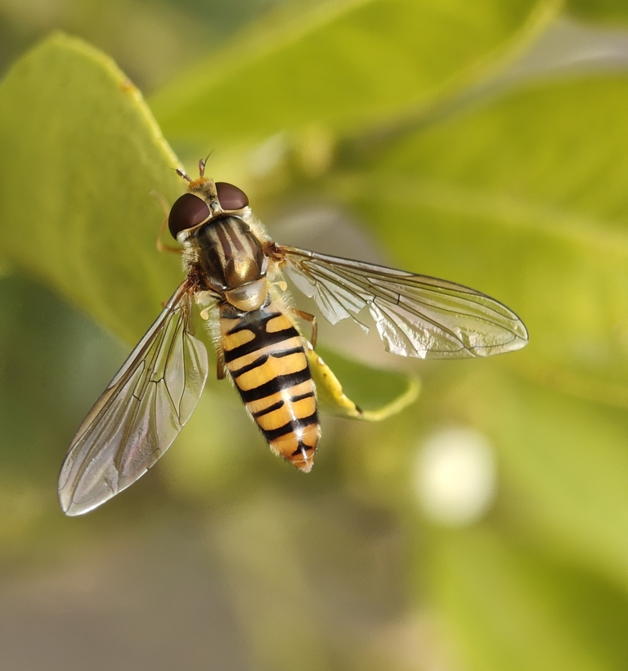
Hoverflies
have tiny antennae
often hover still in the air before landing (bees and wasps have a more direct flight)
often stripy but this can be hard to see on smaller hoverflies
unlike wasps and bees, their large eyes take up most of the face
Notes:
https://www.inaturalist.org/observations/311873892

Slide 25
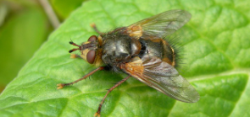
Other flies
many shapes and sizes
many have bristly bodies
can be shiny green or blue, or black, or dull brown or orange

Slide 26
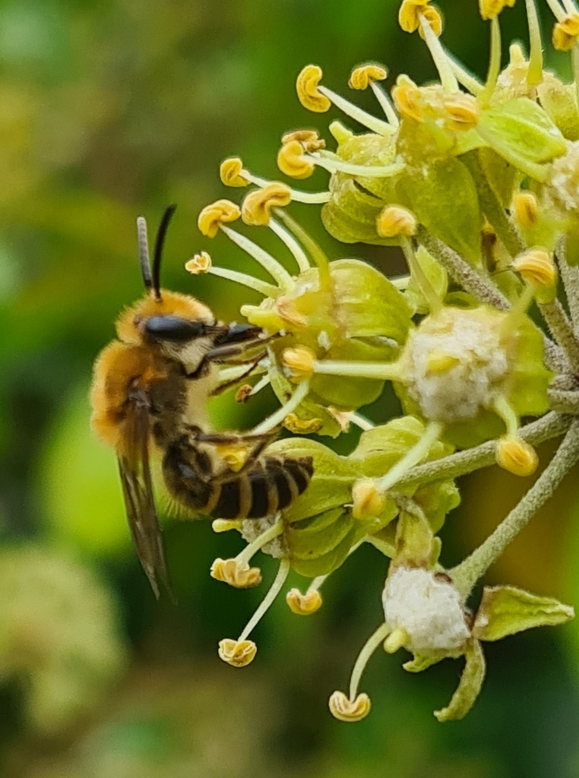
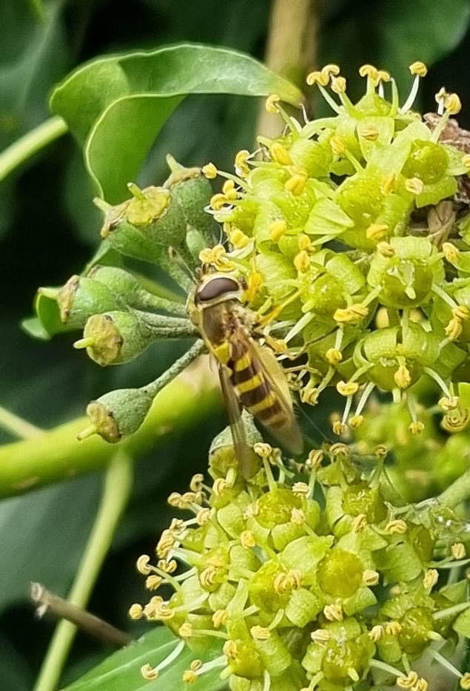
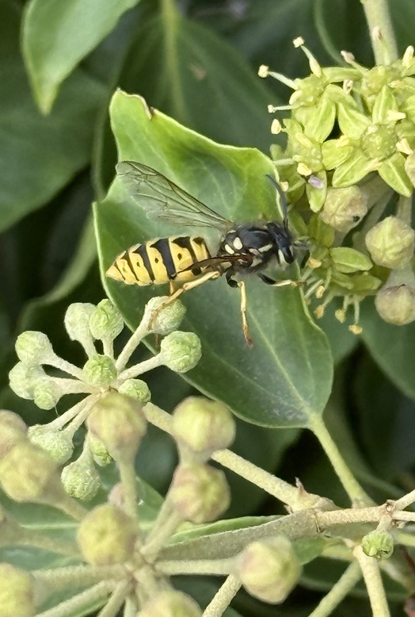
Wasp, solitary bee or hoverfly?
Solitary bee
Hoverfly
Wasp

Slide 27
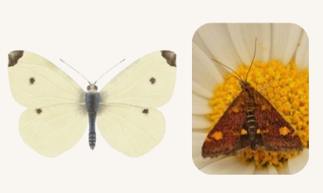
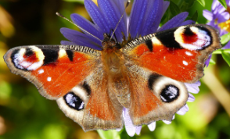
Butterflies and moths
brightly coloured, patterned, brown or white wings
Fun fact: some moths visit flowers during the day – not all fly at night!

Slide 28
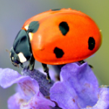
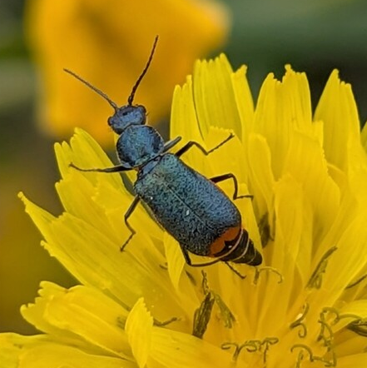
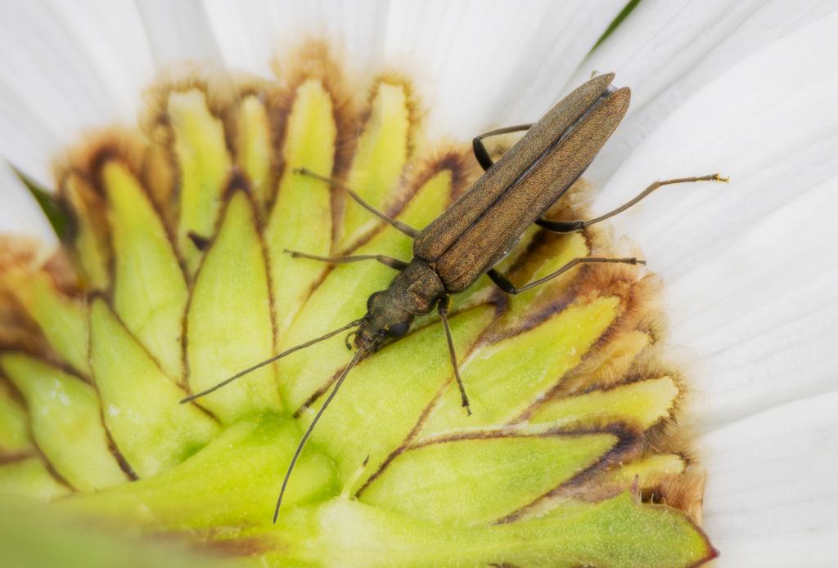
Beetles
can be colourful and shiny, or black and brown
have a straight line down the middle of their back

Slide 29
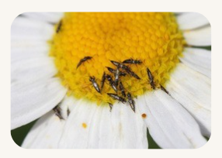
Small insects
anything less than 3mm long (smaller than a grain of rice)
They might be beetles, bugs or flies but it's hard to tell

Slide 30
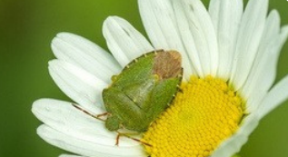
Other insects
anything that does not fit into the other categories

Slide 31
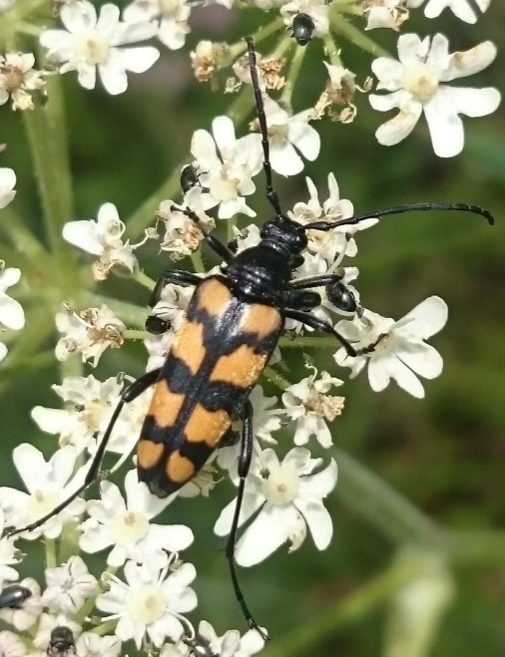
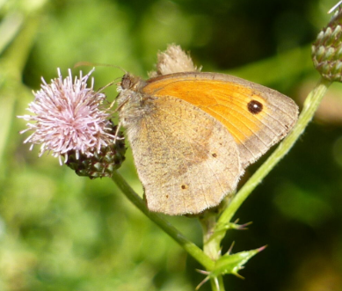
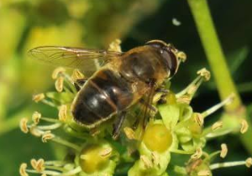
Which group do these insects go into?
Beetles
Butterflies and moths
Hoverflies
Notes:
1 – Four banded longhorn beetle (Leptura quadrifasciata)
2 – Meadow Brown (Maniola jurtina)
3 – Drone fly (Eristalis spp)

Slide 32
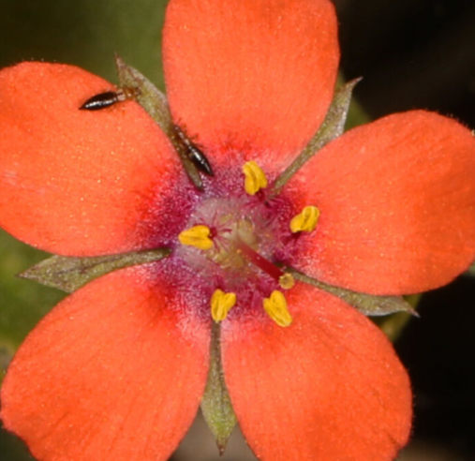
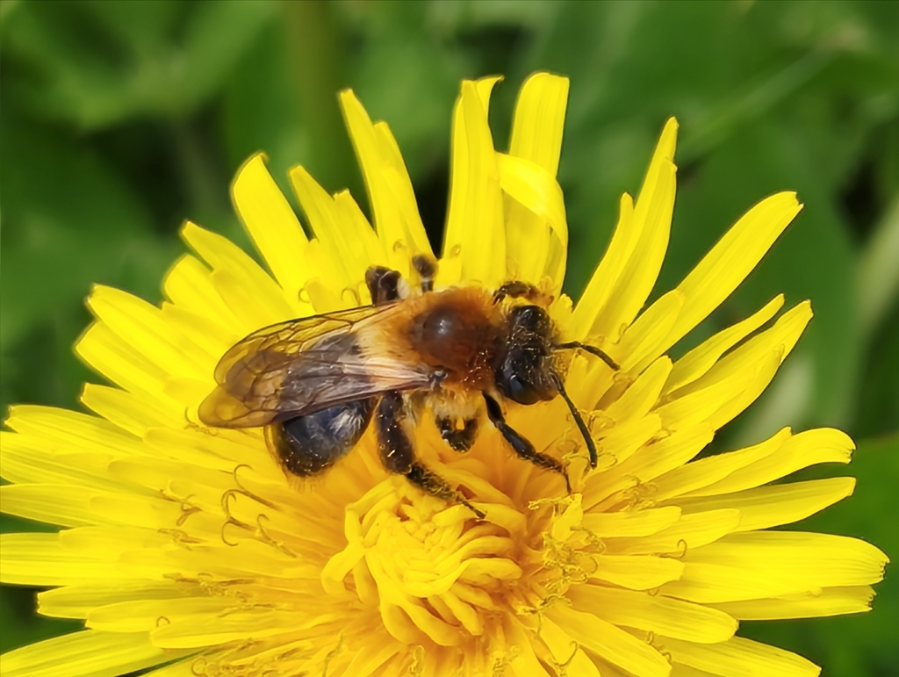
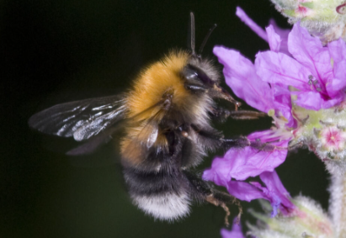
Solitary bees
Bumblebees
Small insects
Notes:
4 – Leafcutter bee (Megachile spp)
5 – Tree Bumblebee (Bombus hypnorum)
6 - Thrips (Thysanoptera)

Slide 33
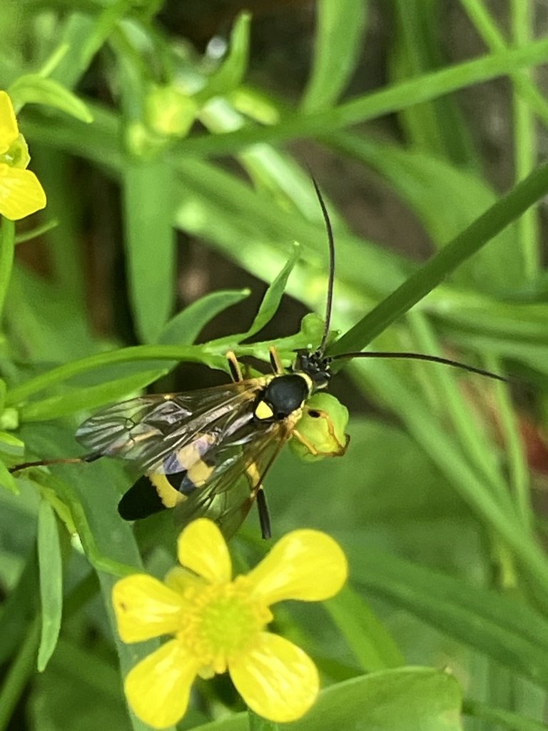
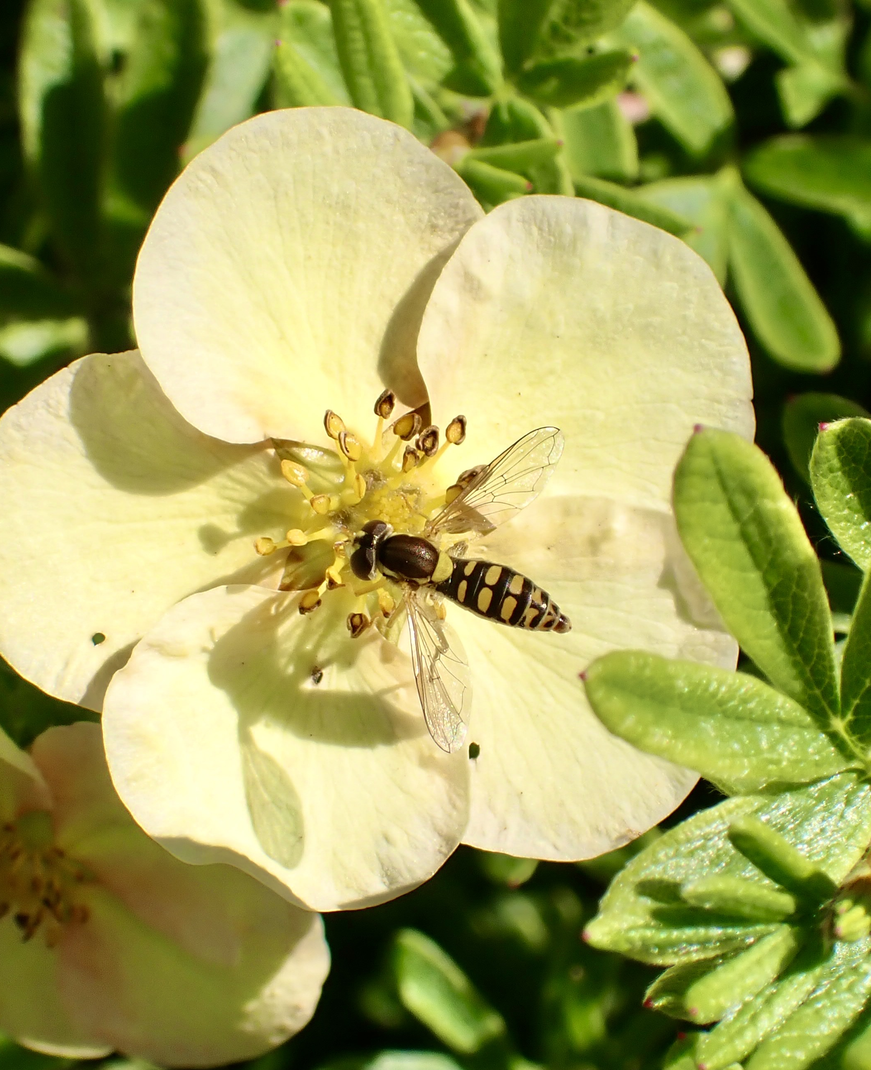
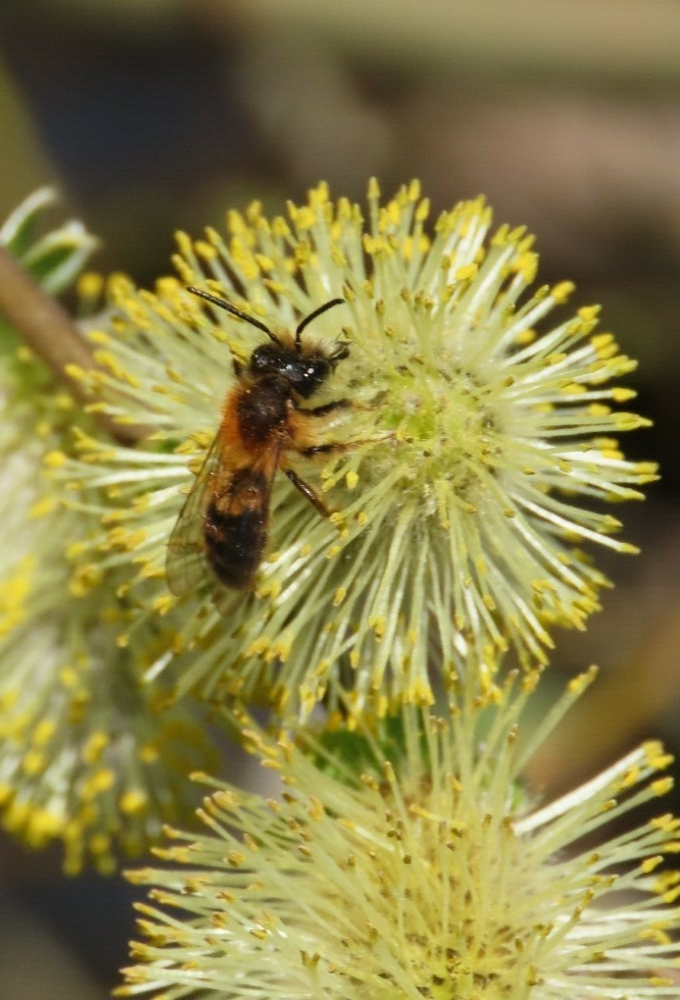
Wasps
Hoverflies
Solitary bees
Notes:
Wasp - Amblyteles armatorius: https://www.inaturalist.org/observations/284759387
Hoverflies – Sphaerophoria
Solitary bee – Tawny Mining bee: https://www.inaturalist.org/observations/203871376

Slide 34
How do we work out what option we choose for flower head?
The flower you have chosen will go into one of these four categories. Each represents one flower unit (head).
A – individual flowers
B – flower heads
C – flower spikes
D – flower umbels

Slide 35
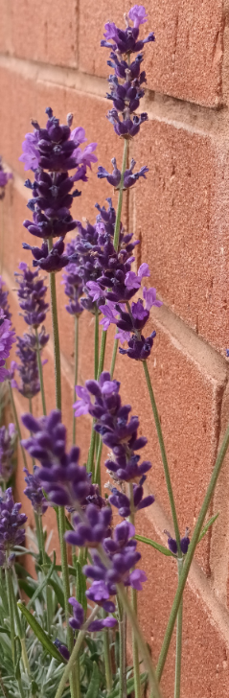
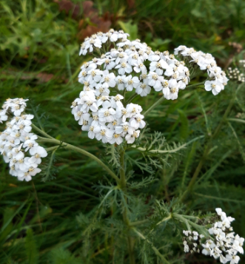


Which category do these plants go in?
C
B
D
A
Notes:
Picture 1 – Common Lavendar (Lavandula angustifolia)
Picture 2 – Oxeye daisy (Leucanthemum vulgare)
Picture 3 – Yarrow (Achillae millefolium)
Picture 4 – Creeping buttercup (Ranunculus repens)

Slide 36
When we come back inside
We will:
enter the results of our survey online on the Nature Park website
start to think about what our results mean
think about where else at school we could do this survey and different things we can investigate e.g. results before and after we let the grass in an area grow long

Slide 37
What happens with the data
we can use our results to find much more about pollinators at school
it will be combined with all the other Pollinator Counts carried out at other schools to answer questions about pollinators nationally
it will be made available to other schools and researchers who can study it and use it in their learning

